Slide 1
ARUN
Arun Kumar
Object Oriented Programming

Slide 2
OOPs
ARUN
Arun Kumar
OOPS Story
Procedural programming vs OOPS
Class vs Object
Code Example of Class & Object
Memory Layout of Class & Object
Instance Variable & Instance Method
Use of this
Constructor & Constructor chaining within Class
Init Block Vs Constructor
Enumerated Type
Access Modifiers
Java Bean & Use
Destructor in Java

Slide 3
OOPs
ARUN
Arun Kumar
How Garbage Collection works in Java
IS-A & HAS-A
Generalization Vs Specialization
Aggregation Vs Composition
Constructor chaining in Inheritance
Polymorphism in Inheritance
Overloading Vs Overriding
Overloading Rules
Overloading with Widening & Wrapper types
Abstract Class
Adapter Class
Interface
Multiple Inheritance in Interface

Slide 4
OOPs
ARUN
Arun Kumar
Abstract class Vs Interface
Interface Rules (Java 8), (default, SAM)
Example of UI, BL, DB, pass by reference
Static variable, Static Block, Static Method
Utility Class
Overriding in Static
Interface with Static (Java 8)
JVM - Memory Architecture
Jconsole, JPS

Slide 5
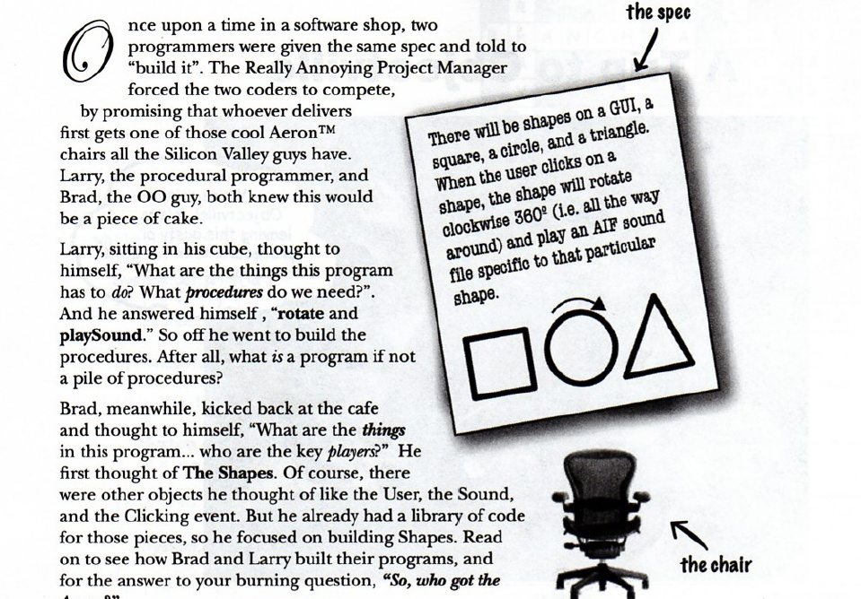
Procedural Vs OOPs
ARUN
Arun Kumar

Slide 6
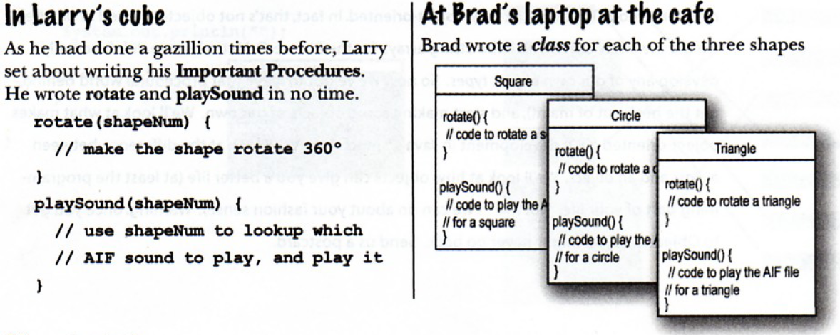
Procedural Vs OOPs
ARUN
ARUN
Arun Kumar
Arun Kumar
Contd….
*

Slide 7
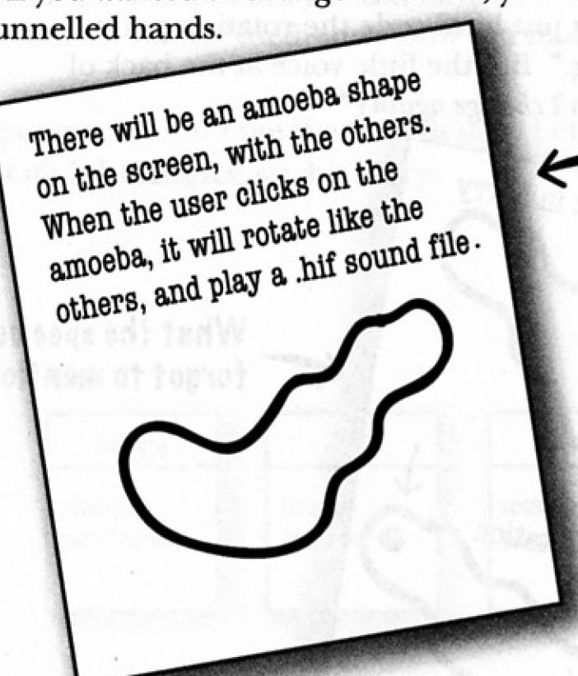
Procedural Vs OOPs
ARUN
ARUN
Arun Kumar
Arun Kumar
Contd….
Add one more shape in your current program
*

Slide 8
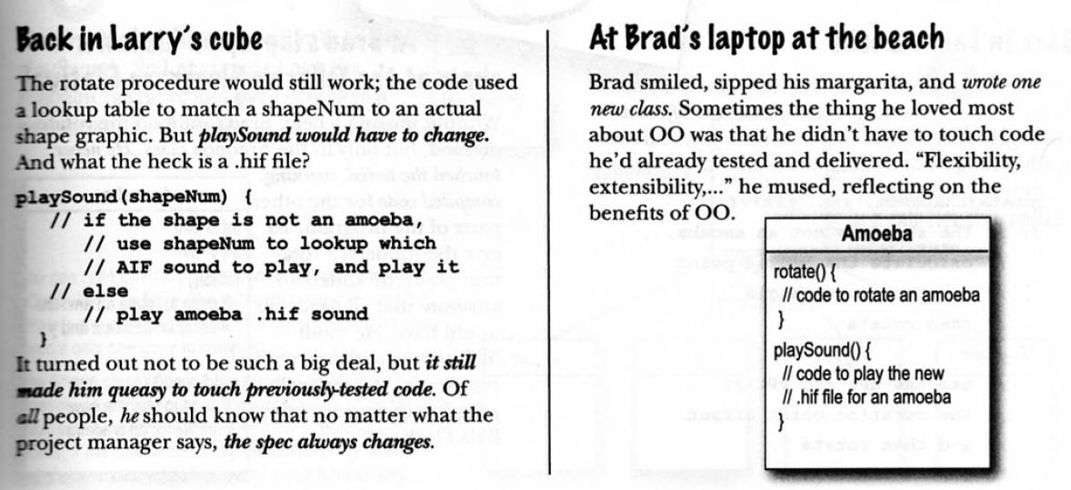
Procedural Vs OOPs
ARUN
ARUN
Arun Kumar
Arun Kumar
Contd….
*

Slide 9
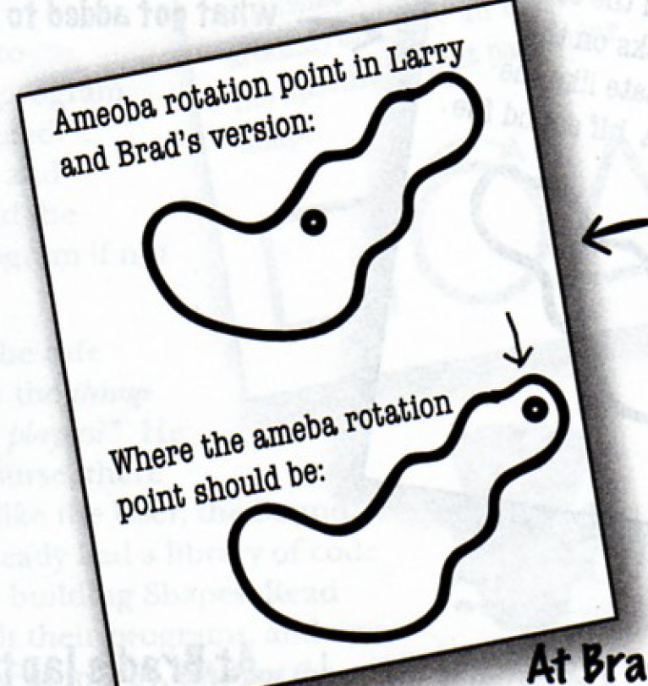
Procedural Vs OOPs
ARUN
ARUN
Arun Kumar
Contd….
*

Slide 10
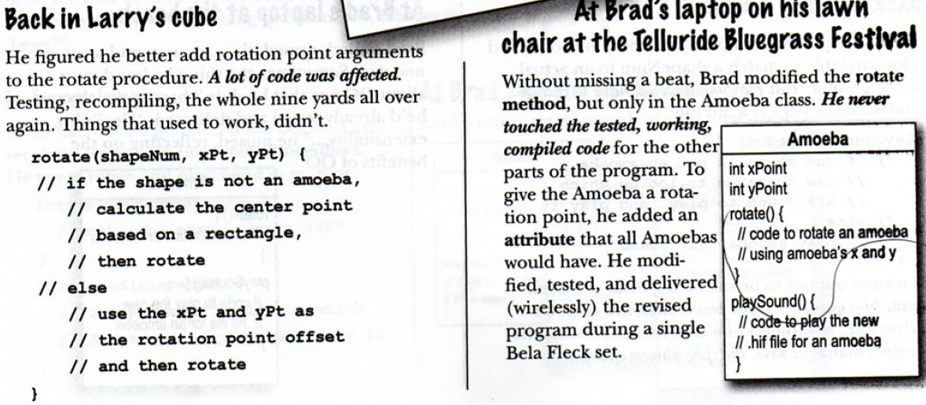
Procedural Vs OOPs
ARUN
ARUN
Arun Kumar
Contd….
*

Slide 11
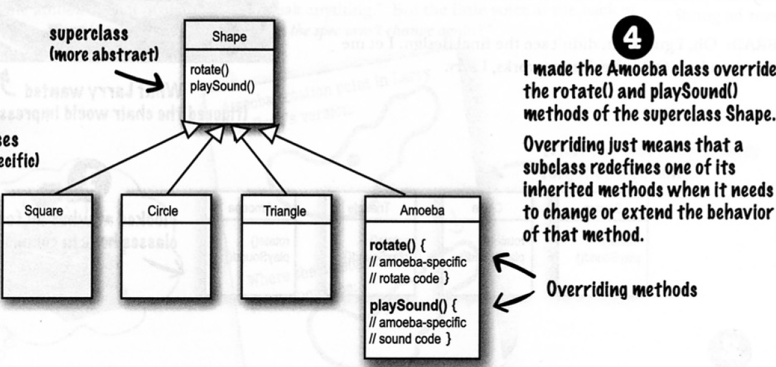
Procedural Vs OOPs
ARUN
Arun Kumar
*

Slide 12
POP vs OOP
ARUN
Arun Kumar
Procedural Oriented Programming | Object Oriented Programming
Programs are made up of procedures, which are set of statements | Programs are made up of modules
Programs cannot be tested separately in procedures. | Programs can be coded and tested separately in modules, and then assembled to form a complete program
Software maintenance can be difficult and time consuming | Software maintenance is relatively easy due to classes and objects
Less secure (No proper Data hiding) | More Secure (Provides Data Hiding)
No Overloading | Overloading is possible

Slide 13
Program Structure
ARUN
Arun Kumar
public class ClassName {
int variableName1;
String variableName2;
void methodName(){
}
public static void main(String [] args){
ClassName object = new ClassName();
}
}
int variableName1;
String variableName2;
Variable in Class
void methodName(){
}
Method Declaration
public static void main(String [] args){
Main Method
ClassName object = new ClassName();
Object Declaration

Slide 14










Class Vs Object
ARUN
Arun Kumar

Slide 15
Class Vs Object
ARUN
Arun Kumar
Actor
Player
Singer

Slide 16
Class Vs Object
ARUN
Arun Kumar
Actor
Player
Singer
Name
Debut date
No of movies
Hits
First movie
Nationality
Name
Debut date
No of matches
Score
Man of the match
Nationality
Name
Debut date
No of tracks
Hits
Nationality

Slide 17
Class Vs Object
ARUN
Arun Kumar
Actor
Player
Singer
class Actors
{
string Name
date Debut-date
int No-of-movies
int Hits
string First movie
string Nationality
}
class Players
{
string Name
date Debut-date
int MatchesPlayed
int Man-of-the-match
string Nationality
}
class Singers
{
string Name
date Debut-date
int No-of-tracks
int hits
string Nationality
}

Slide 18
Class Vs Object
ARUN
Arun Kumar
public class Employee
{
String name;
void work( ){ }
}
Employee emp1 = new Employee( );
emp1.name = “karan”;
emp1.work( );
Employee emp2 = new Employee( );
Class
Object
Template/blue print of object
Behaviors & States
Binds data members and methods into a single unit
Instance/variable of class
Logical exist
Physical exist
Definition is created once
Can be created many times

Slide 19
Object memory layout
ARUN
Arun Kumar
JVM
java Student
Stack
Heap
1544
5649
String Pool
public class Student {
public String name;
public static void main(String [] args) {
Student karan, kunal, kk;
karan = new Student();
kunal = new Student();
kk = kunal;
karan.name =
“karan malhotra”;
kunal.name =
“Kunal kapoor";
} }
name
355
9845
karan malhotra
355
Kunal kapoor
kk
648
9845
name
9845
kunal
null
648
karan
5649
Perm Space (Class loading)
Student + System classes
main()
1544
Notes:
public class Student {
public String name; // Student's name
main()
{
Student std, std1, std2, std3; // Declare four variables of type Student
std = new Student(); // Create a new object belonging to the class Student, and store a reference to that object in the variable std
std1 = new Student(); // Create a second Student object and store a reference to it in the variable std1
std2 = std1; // Copy the reference value in std1 into the variable std2
std3 = null; // Store a null reference in the variable std3
std.name = "John Smith“; // Set values of some instance variables
std1.name = "Mary Jones";
}
// (Other instance variables have default initial values of zero.)
}
When the assignment "std2 = std1;" was executed, no new object was created. Instead, std2 was set to refer to the very same object that std1 refers to.
Note : When one object variable is assigned to another, only a reference is copied. The object referred to is not copied

Slide 20
Instance Variable
ARUN
Arun Kumar
public class VariableDemo {
// Instance Variables
int x, y = 10, total;
String name;
public Variable (){
// ….
}
void add()
{
// …
} } }
// Instance Variables
int x, y = 10, total;
String name;
Name given to data field
Holds value
Declared in a class
- Outside method, constructor, block
Access modifiers can be used
Each object has its own instance variable
- Created with ‘new’ keyword
Notes:
public class Variable {
public String name;
public Variable (String empName){
name = empName;
}
public void printEmp(){
System.out.println("Name is : " + name );
}
public void valueAdd() {
int value = 3;
value = value + 7;
System.out.println("Value is : " + value);
}
public static void main(String args[]) {
Variable val = new Variable("Techknow");
val.valueAdd();
}
}

Slide 21
Instance Method
ARUN
Arun Kumar
Accessible only via object
- Can be called from other method
Performs action for the object
- Instance variables may be used to perform action
public class InstanceMethod {
int x=20, y = 10, total;
}
}
Parameters (if needed)
// Instance Method
int add(){
total = x + y;
return total;
}
access_modifier return_type method_name ( )
{
//……
}
Notes:
public class Variable {
public String name;
public Variable (String empName){
name = empName;
}
public void printEmp(){
System.out.println("Name is : " + name );
}
public void valueAdd() {
int value = 3;
value = value + 7;
System.out.println("Value is : " + value);
}
public static void main(String args[]) {
Variable val = new Variable("Techknow");
val.valueAdd();
}
}

Slide 22
Local Variable
ARUN
Arun Kumar
Declared in methods, constructors or block
- Created when enters in declared method or block
- Can access only within the declared method or block
Access modifiers cannot be used
Internally, implemented at stack level
int x = 20, y=6;
// Instance Method
public int add(){
int total;
total = x + y;
return total;
}
Local Variable
int total;
Notes:
public class Variable {
public String name;
public Variable (String empName){
name = empName;
}
public void printEmp(){
System.out.println("Name is : " + name );
}
public void valueAdd() {
int value = 3;
value = value + 7;
System.out.println("Value is : " + value);
}
public static void main(String args[]) {
Variable val = new Variable("Techknow");
val.valueAdd();
}
}

Slide 23
this
ARUN
Arun Kumar
‘ this ‘ keyword
Refers to the current instance
Within an instance method or a constructor
Can not be used with ‘static’ methods
If used to constructor call, must be the first line in constructor
- Cannot be recursive
Used to
Refer current class instance variable
Invoke current class constructor
Invoke current class method (implicitly)
Used to return the current class instance

Slide 24
this
ARUN
Arun Kumar
Without ‘ this ’ | Using ‘ this’
public class ThisDemo { int x ; int y ; //constructor ThisDemo (int x, int y) { x = x; y = y; } } | public class ThisDemo { int x ; int y ; //constructor ThisDemo (int x, int y) { this.x = x; this.y = y; } }

Slide 25
Constructor
ARUN
Arun Kumar
Constructor has same name as a class name
- Unlike a method, no return type
Called automatically when object is created with ‘new’ keyword
Used to initialize the instance variables
Can‘t make a new object without invoking a constructor
Every class has default constructor
- Even when not declared

Slide 26
Constructor
ARUN
Arun Kumar
Constructor Example :
public class Car {
int no_wheels;
int horse_power;
public static void main(String[] args) {
Car bmw = new Car();
}
}
Car
will call when an
Object
Is created
Car(){
}

Slide 27
Constructors vs Methods
ARUN
Arun Kumar
Constructor
Methods
Initializes class variables
Group Java statements
No return type, not even void
void or a valid return type
Same name as the class
Any name except the class name
‘this’ refers to another constructor in the same class
‘this’ refers to an instance of the current class
‘super’ calls the constructor of the parent class
‘super’ calls an overridden method in the parent class
Not inherited
Inherited
Cannot be abstract, final, native, static, or synchronized (can be public or private)
Can be abstract, final, native, static, or synchronized

Slide 28
this in constructor
ARUN
Arun Kumar
public class Rectangle {
int x, y;
int width = 10, height = 10;
public Rectangle() {
this(5, 5);
}
public Rectangle(int width, int height) {
this(0, 0, width, height);
}
public Rectangle(int x, int y, int width, int height) {
this.x = x;
this.y = y;
this.width = width;
this.height = height;
}
}
Calling parameterised (2 parameter) Constructor
Calling parameterised (4 parameter) Constructor

Slide 29
Constructor chaining
ARUN
Arun Kumar
Constructor chaining
Calling of one constructor from another
Achieved in two ways:
this : Used to call constructor of same class
Super : Used to call constructor of super class

Slide 30
Constructor chaining within Class
ARUN
Arun Kumar
Constructor chaining within class
public class Car {
Car(){
System.out.println("Default Constructor");
}
Car(int i){
this();
System.out.println("Single Parametrized Constructor");
}
Car(int i, int j){
this(j);
System.out.println("Double Parametrized Constructor");
}
public static void main(String[] args) {
Car bmw = new Car(10, 20);
}
}

Slide 31
Constructor chaining within Class
ARUN
Arun Kumar
Constructor chaining within class
public class Car {
Car(){
System.out.println("Default Constructor");
}
Car(int i){
this();
System.out.println("Single Parametrized Constructor");
}
Car(int i, int j){
this(j);
System.out.println("Double Parametrized Constructor");
}
public static void main(String[] args) {
Car bmw = new Car(10, 20);
}
}
Output :
Default Constructor
Single Parametrized Constructor
Double Parametrized Constructor

Slide 32
Constructor chaining in Inheritance
ARUN
Arun Kumar
class Vehicle {
int mileage;
Vehicle(int mileage) {
this. mileage = mileage;
System.out.println(“Mileage of Vehicle: ” + mileage);
}}
class Car extends Vehicle {
int no_wheels;
Car(int mileage, int no_wheels) {
super(mileage);
this. no_wheels = no_wheels;
System.out.println(“no_wheels in Car : ” + no_wheels);
}}
public class TestOverride{
public static void main(String[] args) {
Car bmw = new Car(5, 10);
}}

Slide 33
Constructor chaining in Inheritance
ARUN
Arun Kumar
class Vehicle {
int mileage;
Vehicle(int mileage) {
this. mileage = mileage;
System.out.println(“Mileage of Vehicle: ” + mileage);
}}
class Car extends Vehicle {
int no_wheels;
Car(int mileage, int no_wheels) {
super(mileage);
this. no_wheels = no_wheels;
System.out.println(“no_wheels in Car : ” + no_wheels);
}}
public class TestOverride{
public static void main(String[] args) {
Car bmw = new Car(5, 10);
}}
Output :
mileage of Vehicle : 5
no_wheel in Car : 10

Slide 34
Super Vs this
ARUN
Arun Kumar
super Vs this :
super
this
super keyword always refers to the parent elements like : parent constructor, parent method and parent variables
this keyword always refers to the current class elements like : constructors, methods, variables
Calling parent class methods :
super.parentClassMethodName();
Calling current class methods :
this.parentClassMethodName();
Calling parent class constructor :
super ();
Super(100);
Calling current class constructor :
this ();
this (10);
Using parent class variable in child class :
super.a = 10;
Calling current class variable :
this.a = 10;

Slide 35
Init Block
ARUN
Arun Kumar
Init Block
Method with just curly brace
- No name
- No return type
- No arguments
- No access modifier
- Can be ‘static’
Used to perform
- Initializing the variables
Before constructor calling
- Execution of some statements

Slide 36
Init block vs static block
ARUN
Arun Kumar
 | instance initialization blocks | static initialization blocks
Number of blocks in a class | Many | Many
Gets execute | Before invoking the constructor of that class After the call to this() or super() | Before the non static init block
Order of execution | In which they appear | In which they appear
Example | { // do work } | static { // do work }

Slide 37
Init Block
ARUN
Arun Kumar
Init Block Example :
class Vehicle {
Vehicle () {
System.out.println(“Class constructor.");
}
{
System.out.println(“Init block, before static block.");
}
static {
System.out.println(“Static block.");
}
{
System.out.println(“Init block, after static block.");
}
}

Slide 38
Init Block
ARUN
Arun Kumar
Init Block Example :
class Vehicle {
Vehicle () {
System.out.println(“Class constructor.");
}
{
System.out.println(“Init block, before static block.");
}
static {
System.out.println(“Static block.");
}
{
System.out.println(“Init block, after static block.");
}
}
Output :
Static block
Init block, before static block
Init block, after static block
Class constructor

Slide 39
Init Block
ARUN
Arun Kumar
Init Block in Inheritance :
class Vehicle {
Vehicle() {
print("Vehicle constructor");
}
{
print("Vehicle init, before static");
}
static {
print("Vehicle static block");
}
{
print("Vehicle init, after static");
}
}
class Car extends Vehicle {
Car() {
print(“Car constructor");
}
{
print("Car init, before static");
}
static {
print("Car static block");
}
{
print("Car init, after static");
}
}

Slide 40
Init Block
ARUN
Arun Kumar
Init Block in Inheritance :
class Vehicle {
Vehicle() {
print("Vehicle constructor");
}
{
print("Vehicle init, before static");
}
static {
print("Vehicle static block");
}
{
print("Vehicle init, after static");
}
}
class Car extends Vehicle {
Car() {
print(“Car constructor");
}
{
print("Car init, before static");
}
static {
print("Car static block");
}
{
print("Car init, after static");
}
}
Vehicle static block.
Car static block.
Vehicle init, before static
Vehicle init, after static
Vehicle constructor.
Car init, before static
Car init, after static
Car constructor.
Output :

Slide 41
Enumerated Types
ARUN
Arun Kumar
Enums are lists of constants
Defines a finite set of symbolic names and their values
These symbolic names are usually called enum constants or named constants
Notes:
Package-private is also known as default

Slide 42
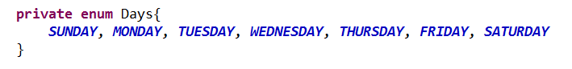
Enumerated Types
ARUN
Arun Kumar
When you need a predefined list of values with symbol
Use an enum
For instance, in a calendar you could use enum to define different week days
Notes:
Package-private is also known as default

Slide 43
Access Modifiers
ARUN
Arun Kumar
Access modifiers determine whether other classes can use a particular field or invoke a particular method
There are two levels of access control:
Top level
public or package-private*
Member level
public, private, protected or package-private*
Notes:
Package-private is also known as default

Slide 44
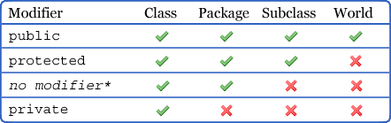
Access Modifiers
ARUN
Arun Kumar

Slide 45
Access Modifiers
ARUN
Arun Kumar
Package1
default
class Parent
private
class Other
class Child
protected
Package2
class GrandChild
public
class Xtra
Package3
class XYZ

Slide 46
Java Bean
ARUN
Arun Kumar
Classes having private instance members and public setter and getter
Reusable software components
Provides a default, no-argument constructor
May have a number of
- properties
Which can be read or written
- "getter" and "setter" methods

Slide 47
Java Bean Methods
ARUN
Arun Kumar
Method | Description
propertyType getPropertyName() Example : public int getId() | Read the property This method is called accessor or getter
void setPropertyName(PropertyName pn) Example : public void setId(int id) | Write the property. This method is called mutator or setter
boolean isEmpty() Example : public boolean isIs_valid() | Checks if the property is empty or not
boolean addPropertyName(PropertyName pn) | Add the property
boolean removePropertyName(PropertyName pn) | Delete the propery

Slide 48
Java Bean
ARUN
Arun Kumar
Example :
public class StudentBean {
private int id;
private String name;
private boolean is_valid;
public int getId() {
return id;
}
public void setId(int id) {
this.id = id;
}
public String getName() {
return name;
}
public void setName(String name) {
this.name = name;
}
public boolean isIs_valid() {
return is_valid;
}
public void setIs_valid(boolean is_valid) {
this.is_valid = is_valid;
}
}

Slide 49
Destructor/finalize() in Java
ARUN
Arun Kumar
Destructor
- Free up the memory
- Close the opened resources
No destructor in Java
- use the finalize() method for this purpose
finalize() method depends on Garbage Collection

Slide 50
Destructor/finalize() in Java
ARUN
Arun Kumar
public class Data{
public void connectPrinter(){
//....
}
public void connectDataBase(){
//....
}
protected void finalize() {
// close the printer connection
// close the database connection
}
}

Slide 51
Garbage Collection
ARUN
Arun Kumar
Eligibility for garbage collection :
Objects that are not reachable are considered garbage
Object is created inside a block and reference goes out scope once control exit that block
If associated object set to null (if there any)
Garbage collection can be request by calling System.gc() or Runtime.getRuntime().gc()
Notes:
WeakHashMap : Hash table based implementation of the Map interface, with weak keys. An entry in a WeakHashMap will automatically be removed when its key is no longer in ordinary use. More precisely, the presence of a mapping for a given key will not prevent the key from being discarded by the garbage collector, that is, made finalizable, finalized, and then reclaimed. When a key has been discarded its entry is effectively removed from the map, so this class behaves somewhat differently from other Map implementations.

Slide 52
Garbage Collection Process
ARUN
Arun Kumar
Java objects are created in Heap and Heap is divided into three parts or generations for sake of garbage collection :
Young generation (Eden Space)
Old Generation
Perm Area of heap
Survivor 1
Survivor 2
Young Generation is further divided into Survivor 1 and Survivor 2 space
When an object first created in heap its gets created in young generation inside Eden space and after subsequent Minor Garbage collection if object survives its gets moved to survivor 1 and then Survivor 2 before Major Garbage collection moved that object to Old generation
Permanent generation or Perm Area of Heap is somewhat special and it is used to store Meta data related to classes and method in JVM

Slide 53
Garbage Collection
ARUN
Arun Kumar
new Object();
tkhts
tkhts
S1
Minor GC
Sam
Eden
Young Generation
tkhts
new Object();
Sam
S2
tkhts
Major GC
Albie
Brian
Old Generation
Pam
john
Peter

Slide 54
Determine Garbage Collection
ARUN
Arun Kumar
To determine garbage collection, use command :
java –verbose:gc HelloWorld
output of above command should be something like
GC 325407K->83000K(776768K), 0.2300771 sec
GC – Indicates that it was a minor garbage collection (young generation)
Full GC indicates that it was a major garbage collection (tenured generation)
325407K – The combined size of live objects before garbage collection.
83000K – The combined size of live objects after garbage collection.
(776768K) – the total available space, not counting the space in the permanent generation
0.2300771 sec – time it took for garbage collection to occur
Notes:
WeakHashMap : Hash table based implementation of the Map interface, with weak keys. An entry in a WeakHashMap will automatically be removed when its key is no longer in ordinary use. More precisely, the presence of a mapping for a given key will not prevent the key from being discarded by the garbage collector, that is, made finalizable, finalized, and then reclaimed. When a key has been discarded its entry is effectively removed from the map, so this class behaves somewhat differently from other Map implementations.

Slide 55
IS-A & HAS-A
ARUN
Arun Kumar
Code reusability is also an advantage of OOP
Ways to reuse the code
IS-A (Implementation of inheritance)
HAS-A (Object composition)
Vehicle
IS-A
Extends
Creates an object
Car
HAS-A
Engine

Slide 56
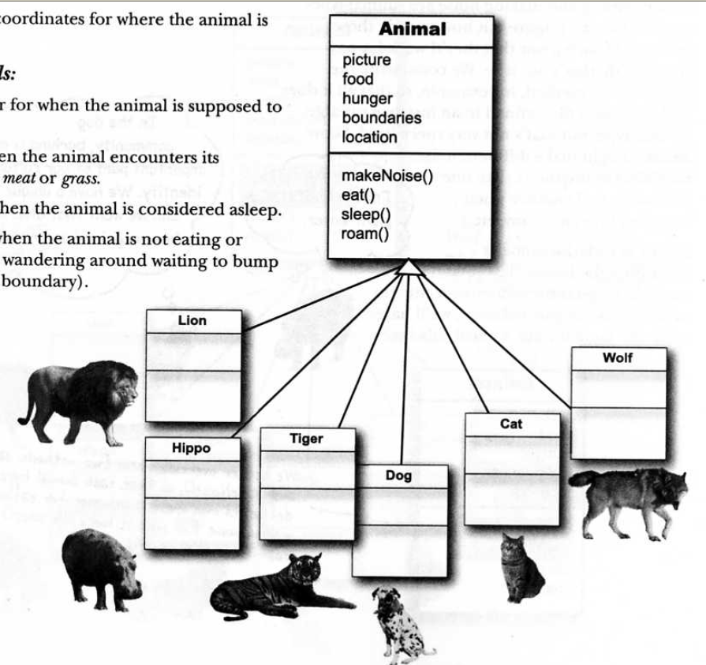
IS-A
ARUN
Arun Kumar
Inheritance Tree
Lion IS-A Animal
Hippo IS-A Animal
Tiger IS-A Animal

Slide 57
IS-A
ARUN
Arun Kumar
Account
Account number
CurrentAccount
Account number
loan
SavingAccount
Account number

Slide 58
IS-A & HAS-A
ARUN
Arun Kumar
 | IS-A | HAS-A
Based on | Inheritance or interface (Parent child relationship) | Usage
Used by | Extends or implements keyword | Making an object of the other class
Advantage | Code reusability | Work on other class
Example | Horse is an Animal, AutoLoan IS-A Loan | Horse HAS-A Halter, Customer HAS-A Loan

Slide 59
Inheritance type
ARUN
Arun Kumar
Single Inheritance
Multilevel Inheritance
Parent
Parent
Child
Hierarchical Inheritance
Child
Parent
Grand Child
Child-1
Child-2
Notes:
Java does not support Multiple Inheritance. Multiple Inheritance can be achieved in java through the implementation of Interfaces

Slide 60
Generalization
ARUN
Arun Kumar
Partially share the same attributes
Auto Loan
Home Loan
amount
duration
roi
amount
duration
roi
Bank Loan
amount
duration
roi
discount
Shared characteristics are combined to create Bank Loan
Subclasses of Bank Loan
Auto Loan
Home Loan
discount

Slide 61
Specialization
ARUN
Arun Kumar
Loan
amount
duration
roi
discount
Bank Loan
Combination of 2 similar but different classes
amount
duration
roi
Specitalization is to form the special classes
Needed only for Auto Loan
Placed discount where it belongs
Auto Loan
Home Loan
discount
Subclasses of Bank Loan

Slide 62
Generalization Vs Specialization
ARUN
Arun Kumar
Generalization | Specialization
Process of extracting shared characteristics from two or more classes | Creating new subclasses from an existing class
Shared characteristics can be attributes, associations, or methods | If it turns out that certain attributes, associations, or methods only apply to some of the objects of the class, a subclass can be created
Called Superclass and located on the top | Called Subclass and located below the superclass

Slide 63
Association
ARUN
Arun Kumar
HAS-A relationship between classes
A class knows other class
Holds reference of other class
Association
Aggregation
Compostion
Relationship can be bi-directional

Slide 64
Aggregation
ARUN
Arun Kumar
HAS-A relationship
Based on usage
Allows to have
Good object-oriented practice
Code reusability
Employee has-a Department
Employee
name
Dept
Dept
name

Slide 65
Composition
ARUN
Arun Kumar
Relationship
One object is responsible for the lifetime of the object it holds
Subject can not exist without Student
Student
Subject
Student class is responsible for creation and destruction of Subject class

Slide 66
Encapsulation
ARUN
Arun Kumar
Binding of "Data and Method" into a single unit
Good encapsulation
Private/protected data
Public methods
Example of Encapsulation
Human Brain, Capsule
Hidden from the outer world
class Emp
{ String name; // DATA
void input() //METHOD
{ name=”MIKE”;
}
void show()
{ System.out.println(“Name is “+name);
}
}

Slide 67
Abstraction
ARUN
Arun Kumar
Working on the essential things and forget the unessential things
Example of Abstraction in Java is abstract classes, interfaces
If I drive car, I only have to know how to use brakes, accelerator, gear, clutch etc.
I don’t need to know internal working of these things.
Unessential things Hidden

Slide 68
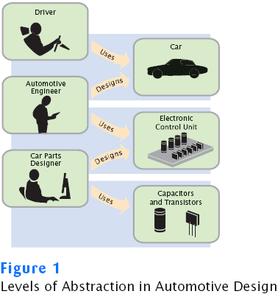
Abstraction
ARUN
Arun Kumar
Unessential things are hidden

Slide 69
Inheritance
ARUN
Arun Kumar
Used to show parent - child relationship
Provides the code reusability
Example:
CAR IS A Vehicle
CAR inherits the feature of Vehicle
Brakes
Wheels
Horn
Clutch
Vehicle
Breaks, Wheels, Horn, Clutch
CAR
Bike

Slide 70
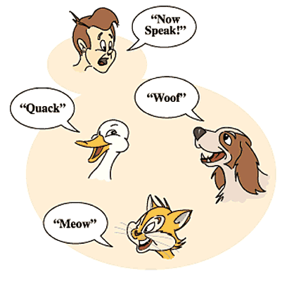
Polymorphism in Inheritance
ARUN
Arun Kumar
Polymorphism : One thing having several forms.
Example: All Animals have sound but they sounds differently like Cat sounds ‘Meow’, Duck sounds ‘Quack’ and Dog sounds ‘Woof’.
Example :
void add(int x, int y)
{
System.out.println(x+y);
}
void add(float x, float y)
{
System.out.println(x+y);
}
void add(int a, int b, int c)
{
System.out.println(a+b+c);
}

Slide 71
Overloading Vs Overriding
ARUN
Arun Kumar
Overloading
Overriding
Overloaded methods let you reuse the same method name in a class, but with different arguments and optionally, a different return type
Any time you have a class that inherits a method from a superclass, you have the opportunity to override the method
Overloaded methods must change the argument list
The argument list must be same
A method can be overloaded in the same class or in a subclass
Without inheritance no overriding
Overloaded methods can change the access modifier
The access level can't be less restrictive in overridden method
Overloaded methods can declare new or broader checked exceptions
Can throw any unchecked exception by overriding. The overridden method can throw any sub type or same type exception of overriding method
Can overload final and static methods
You cannot override a method marked final and static

Slide 72
Overloading
ARUN
Arun Kumar
class Calculator{
public void add(int x, int y){
println(x + y);
}
public void add(int x, int y, int z){
println(x + y + z);
}
public void add(float x, float y){
println(x + y);
}
public int add(long x, long y){
return (int) ( x + y);
}
main(String [] args){
Calculator obj = new Calculator();
obj.add(10l, 20l);
obj.add(10.1f, 20.1f);
obj.add(10, 20, 30);
obj.add(10, 20);
}}

Slide 73
Overriding
ARUN
Arun Kumar
class CasioCalculator extends Calculator{
public void add(int x, int y){
println(x + y);
}
public void add(int x, int y, int z){
println(x + y + z);
}
}
class TestCalculator{
public static void main(String[] args) {
casiocalc.add(10, 20);
casiocalc.add(10, 20, 30);
}
}
class Calculator{
public void add(int x, int y){
println(x + y);
}
public void add(int x, int y, int z){
println(x + y + z);
}
}

Slide 74
Overloading with Widening, Wrappers & Var-args
ARUN
Arun Kumar
Some rules for overloading in Widening, Wrapper & Var-args
int -> long
Widening
Widening beats Wrapper
Widening beats Var-args
Integer - > Long
Wrapper
Wrapper beats Var-args
Integer …
Var-args

Slide 75
Overloading with Widening, Wrappers & Var-args
ARUN
Arun Kumar
Widening | Wrappers | Var-args
/*In this Example byte will convert into int automatically as int is greater than byte*/
public class Calculator {
public void show(int a){
print("Inside int");
}
public void show(long a){
print("Inside long");
}
main(String[] args) {
Calculator calc = new Calculator();
byte a = 20;
calc.show(a);
}
}
/*In this Example int
automatically convert to
long*/
public class Calculator {
public void show(Integer a){
print("Inside Integer");
}
public void show(long a){
print("Inside long");
}
main(String[] args) {
Calculator calc = new Calculator();
int a = 20;
calc.show(a);
}
}
/*In this Example byte will
automatically convert into int
var-args*/
public class Calculator {
public void show(long… a){
print("Inside long");
}
public void show(int… a){
print("Inside int");
}
main(String[] args) {
Calculator calc = new Calculator();
byte a = 20;
calc.show(a);
}
}

Slide 76
Overloading with Widening, Wrappers & Var-args
ARUN
Arun Kumar
Widening | Wrappers | Var-args
/*In this Example byte will convert into int automatically as int is greater than byte*/
public class Calculator {
public void show(int a){
print("Inside int");
}
public void show(long a){
print("Inside long");
}
main(String[] args) {
Calculator calc = new Calculator();
byte a = 20;
calc.show(a);
}
}
/*In this Example int
automatically convert to
long*/
public class Calculator {
public void show(Integer a){
print("Inside Integer");
}
public void show(long a){
print("Inside long");
}
main(String[] args) {
Calculator calc = new Calculator();
int a = 20;
calc.show(a);
}
}
/*In this Example byte will
automatically convert into int
var-args*/
public class Calculator {
public void show(long… a){
print("Inside long");
}
public void show(int… a){
print("Inside int");
}
main(String[] args) {
Calculator calc = new Calculator();
byte a = 20;
calc.show(a);
}
}
Output : Inside int

Slide 77
Overloading with Widening, Wrappers & Var-args
ARUN
Arun Kumar
Widening | Wrappers | Var-args
/*In this Example byte will convert into int automatically as int is greater than byte*/
public class Calculator {
public void show(int a){
print("Inside int");
}
public void show(long a){
print("Inside long");
}
main(String[] args) {
Calculator calc = new Calculator();
byte a = 20;
calc.show(a);
}
}
/*In this Example int
automatically convert to
long*/
public class Calculator {
public void show(Integer a){
print("Inside Integer");
}
public void show(long a){
print("Inside long");
}
main(String[] args) {
Calculator calc = new Calculator();
int a = 20;
calc.show(a);
}
}
/*In this Example byte will
automatically convert into int
var-args*/
public class Calculator {
public void show(long… a){
print("Inside long");
}
public void show(int… a){
print("Inside int");
}
main(String[] args) {
Calculator calc = new Calculator();
byte a = 20;
calc.show(a);
}
}
Output : Inside int
Output : Inside long

Slide 78
Overloading with Widening, Wrappers & Var-args
ARUN
Arun Kumar
Widening | Wrappers | Var-args
/*In this Example byte will convert into int automatically as int is greater than byte*/
public class Calculator {
public void show(int a){
print("Inside int");
}
public void show(long a){
print("Inside long");
}
main(String[] args) {
Calculator calc = new Calculator();
byte a = 20;
calc.show(a);
}
}
/*In this Example int
automatically convert to
long*/
public class Calculator {
public void show(Integer a){
print("Inside Integer");
}
public void show(long a){
print("Inside long");
}
main(String[] args) {
Calculator calc = new Calculator();
int a = 20;
calc.show(a);
}
}
/*In this Example byte will
automatically convert into int
var-args*/
public class Calculator {
public void show(long… a){
print("Inside long");
}
public void show(int… a){
print("Inside int");
}
main(String[] args) {
Calculator calc = new Calculator();
byte a = 20;
calc.show(a);
}
}
Output : Inside int
Output : Inside long
Output : Inside int

Slide 79
Abstract Class
ARUN
Arun Kumar
May have abstract method
Method without body
When inherited, the subclass provides body for all the abstract methods
If it does not, subclass must also be abstract
Can not be instantiated
But can be invoked if main() present
Has generic methods common to all sub classes
Declared as abstract
abstract class AbstractDemo {
abstract void draw();
}

Slide 80
Interface
ARUN
Arun Kumar
Contains methods and constants
Methods are abstract
Fields are final
Do not specify any code
Implementing class has the responsibility to write the code
interface Name_of_interface
{
data_type constant = value; // static, final
return_type method_name(arguments); //public
}

Slide 81
Multiple Inheritance in Interface
ARUN
Arun Kumar
Multiple inheritance can cause the diamond problem
Java does not have multiple inheritance
Classes having method do();
do( );
do( );
do( );
do( );
extends
do( );
do( );
do( );
do( );
extends
do( );
do( );
do( );
do( );
Which method should be here
diamond problem

Slide 82
Multiple Inheritance in Interface
ARUN
Arun Kumar
Interfaces allow flavor of multiple inheritance
interfaces having method do();
do( );
do( );
do( );
do( );
implements
do( );
Class will create body itself
Multiple Inheritance

Slide 83
Adaptor Class
ARUN
Arun Kumar
Provides a dummy (empty) implementation for an interface
Implement the interface but do not want to implement all methods
Use the adapter class
Only override the methods you want
Changes will be made only in adaptor class if needed
Interfaces
1
2
3
4
Adaptor Class
classes
Use only needed methods from interfaces

Slide 84
Abstract Vs Interface
ARUN
Arun Kumar
Abstract class
Interface
Methods may have body
Methods are implicitly abstract and will not have body
May contain non-final & non-static variables
Variables are by default final & static
Extended using extends keyword
Implemented using implements keyword
Can extend another class and implement multiple interfaces
can not extend other class, but multiple interfaces can be extended
Can not be instantiated but can be invoked if main method exists
100% abstract and can not be instantiated
Faster than interface
Slower than abstract classes as they require extra indirections

Slide 85
Interface Rules
Java 8 - Default
ARUN
Arun Kumar
Class extending adaptor class can not extend any other class
Java 8 reduces the need of adaptor class
Interfaces
Interfaces with body
A
B
do( ){ … }
do( ){ … }
implements
implements
Adaptor Class
classes
extends
A.super.do( );
B.super.do( );
Use only needed methods from interfaces

Slide 86
Interface – Java 8
Default, Defender or Virtual Extension Method
ARUN
Arun Kumar
interface A
{
default void show()
{
System.out.println("A Show");
}
}
class C implements A,B
{
public void show()
{
A.super.show();
B.super.show();
}
}
interface B
{
default void show()
{
System.out.println("B Show");
}
}

Slide 87
SAM Interface
Java 8
ARUN
Arun Kumar
Annotation introduced
@FunctionalInterface
Functional Interface
@FunctionalInterface
public interface MyFunctionalInterface
{
public void show();
public String toString();
//public void display();
}
Single Abstract Method
Abstract method from the java.lang.Object class
Notes:
SAM – Single Abstract Method

Slide 88
Pass By Value
ARUN
Arun Kumar
Value of actual parameter is copied into a location being used to hold the formal parameter's value during
Location is typically a chunk of memory on the runtime stack for the application
class Calc{
public void getSquare(float f){
f = f*f;
System.out.println("Square is "+f);
}}
public class PassByValue {
public static void main(String[] args) {
float num = 2.35f;
System.out.println(“Number before getting the square is "+num);
Calc calc = new Calc();
calc.getSquare(num);
System.out.println(“Number after getting the square is "+num);
} }
copy of num

Slide 89
Pass By Reference
ARUN
Arun Kumar
Alias for the actual parameter
Actually using the actual parameter
class Calc{
public void getSquare(Number obj){
obj.num = obj.num * obj.num;
System.out.println("Square is "+obj.num);
}}
class Number{
float num;
}
public class CallByReference {
public static void main(String[] args) {
Calc calc = new Calc();
Number number = new Number();
number.num = 2.35f;
System.out.println("The number before getting the square is "+number.num);
calc.getSquare(number);
System.out.println("The number after getting the square is "+number.num);
}}
copy of reference number

Slide 90
UI, BL, DB
ARUN
Arun Kumar
UI
BL
DB
login()
UserId
validateData()
Password
isRegistered()
true
DTO
isAuthorisedUser()
false
DTO
DTO
true
false
true
Invalid User
Welcome User

Slide 91
Utility Classes
ARUN
Arun Kumar
Performs common/re-used functions
Mostly have only static methods
Typically have no state (variables)
Example:
Make connection with database
Print data
Math operations
Square, square-root, sin(), tan(), cube, etc.
Generate random number
Sorting

Slide 92
Overriding in Static
ARUN
Arun Kumar
Can declare static methods with same signature in subclass
Not considered overriding
No run-time polymorphism
Derived class static method hides the method in the base class

Slide 93
Overriding in Static
ARUN
Arun Kumar
Important points for method overriding and static methods:
Static method would be called based on the run time type of the object
Non-static method is called at run time according to the type of object being referred
Non-static method cannot override a static method, and a static method cannot hide an instance method

Slide 94
JVM
ARUN
Arun Kumar
Abstract machine
Provides the runtime environment
Where bytecodes are executed
Available for many Platforms
Platform dependent
Performs
Class Loader
Byte Code Verifier
Interpreter / JIT
Generate native code

Slide 95
Architecture JVM
ARUN
Arun Kumar
Class File
Class Loader
JVM allocated memory areas
Java Runtime System
Class Area
Java Stacks
PC Registers
Native Method Stacks
Heap
Native Method Interface
Native Method Libraries
Interpreter
JIT Compiler
Execution Engine
Operating System

Slide 96
Architecture JVM
ARUN
Arun Kumar
Class Loader-
Subsystem of JVM that loads class files
Class(Method) Area-
Stores per-class structures as
Runtime constant pool, field and method data, the code for methods
Heap-
Runtime data area where objects are allocated
Stack-
Stores frames to hold local variables and partial results
Each thread has a private JVM stack
New frame is created each time a method is invoked
destroyed when method invocation completes

Slide 97
Architecture JVM
ARUN
Arun Kumar
PC (Program Counter) Register
Contains the address of the currently being executed JVM instructions
Native Method Stack
Contains all the native methods used in the application
Execution Engine
A virtual processor
Interpreter: Read bytecode stream then execute
Just-In-Time(JIT) compiler: compiles parts of the byte code that have similar functionality at the same time, and hence improves performance

Slide 98
Jconsole
ARUN
Arun Kumar
GUI tool
Displays monitoring diagrams for
Heap memory usage
Counts on loaded classes
Counts on threads
CPU usages

Slide 99
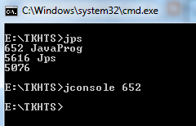
JPS
ARUN
Arun Kumar
Run your java program/application
Open command prompt and type
JPS
Now type jconsole with the processing id of your java application
My Java Application
My Java Application pid

Slide 100
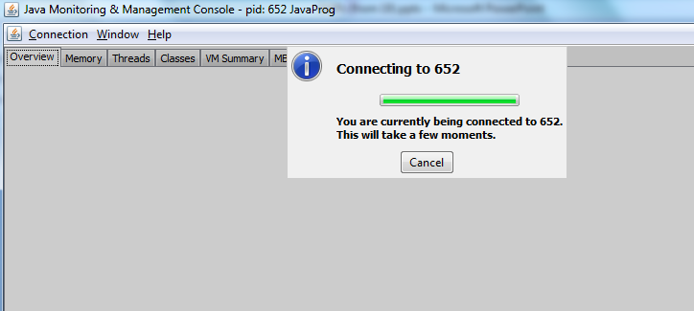
Jconsole and JPS
ARUN
Arun Kumar
Jconsole will create connection with the process id as shown

Slide 101
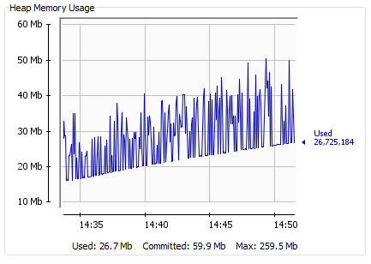
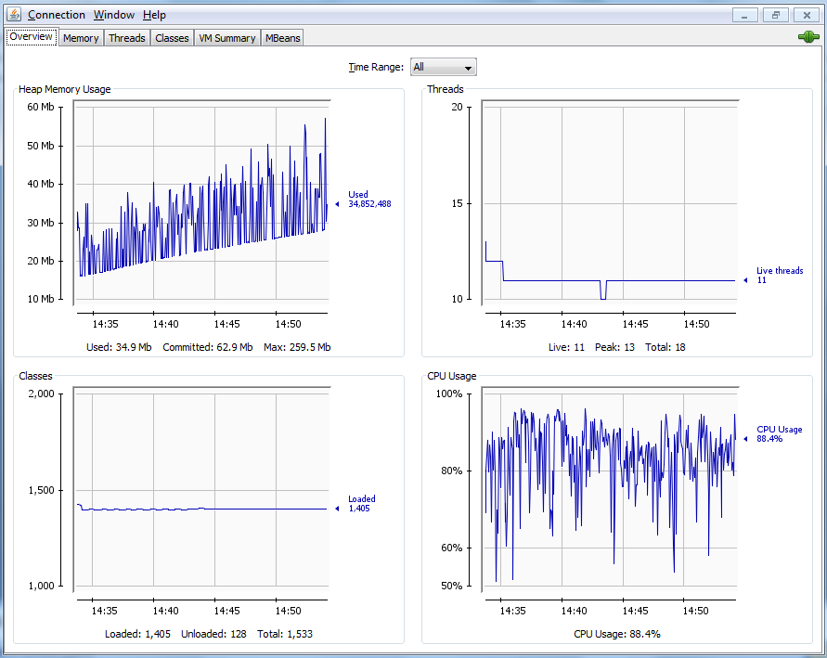
Jconsole and JPS
ARUN
Arun Kumar
Threads
Heap Memory Usage
Classes
CPU Usage

